Slide 1

CCLDAS Database User Manual

Slide 2
Overview
The CCLDAS database includes labview programs designed to post data from the labview environment to an SQL database
A labview query program then searches the SQL database, retrieves datasets, then writes them to an HDF5 file
Several IDL programs can then be used to open these HDF5 files and import the data into IDL for analysis

Slide 3
Labview Enqueuing Programs
Sub Vis Post_Pelletron_Tick.vi and Post_Dust_Event_Tick.vi can be called by other Vis that generate data or import data into the labview envronment. They then enqueue data and open the dequeuing database connection VI.

Slide 4
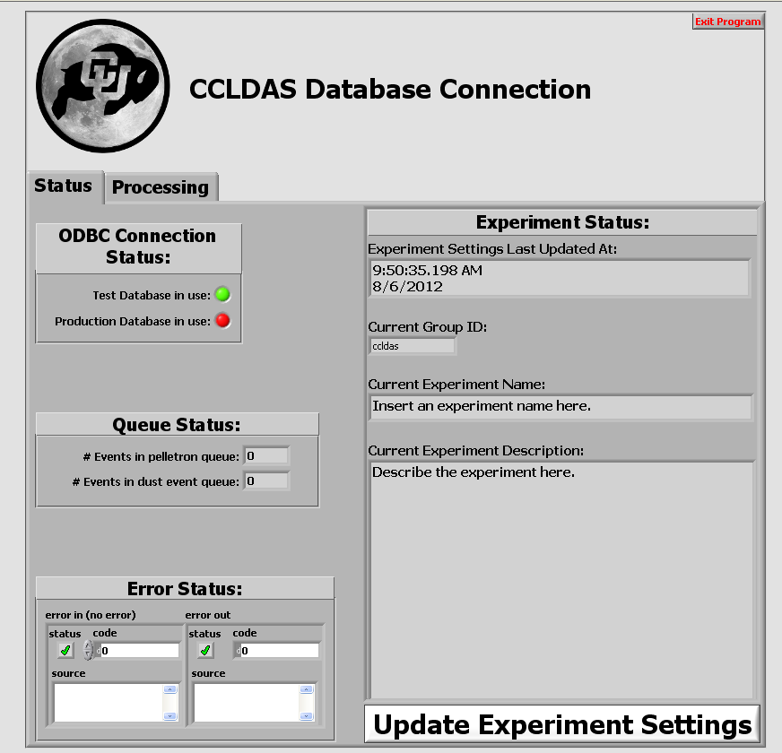
Labview Database Connection VI
The public vi Database Connection.vi dequeues data and posts it to SQL. It has error, ODBC status, and queue status indicators that can be used to easily confirm that the program is running properly.

Slide 5
Labview Database Connection VI
Database Connection.vi also allows users to view define experiment settings such as the current group performing an experiment, the experiment name, and an experiment description.

Slide 6
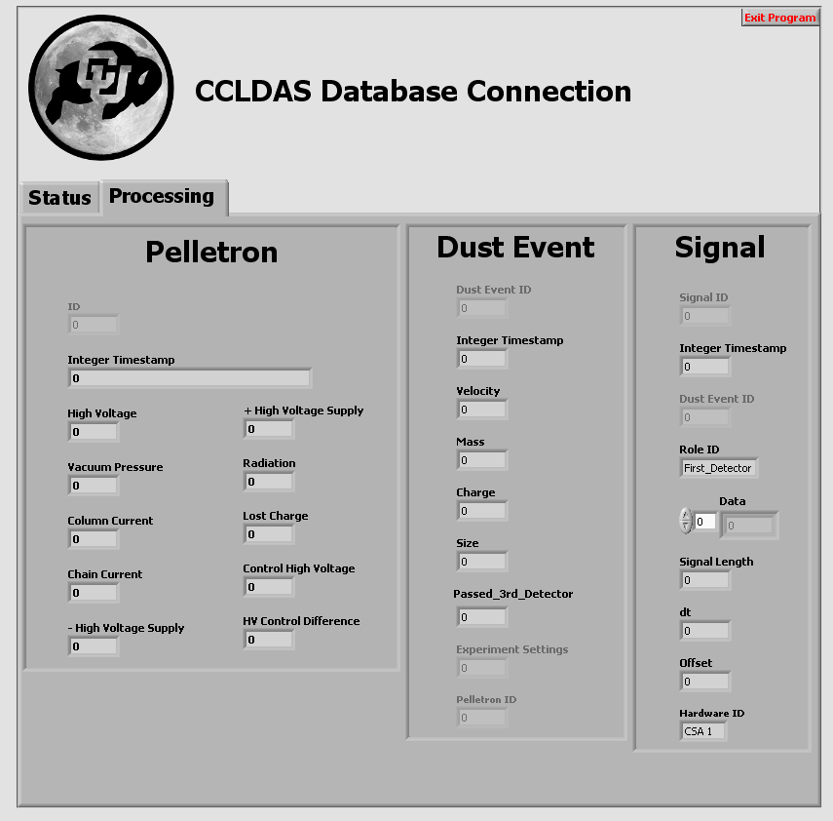
Labview Database Connection VI
The data that is being dequeued and posted can be viewed as it is posted from the processing tab to provide a further check on the operation of the program.

Slide 7
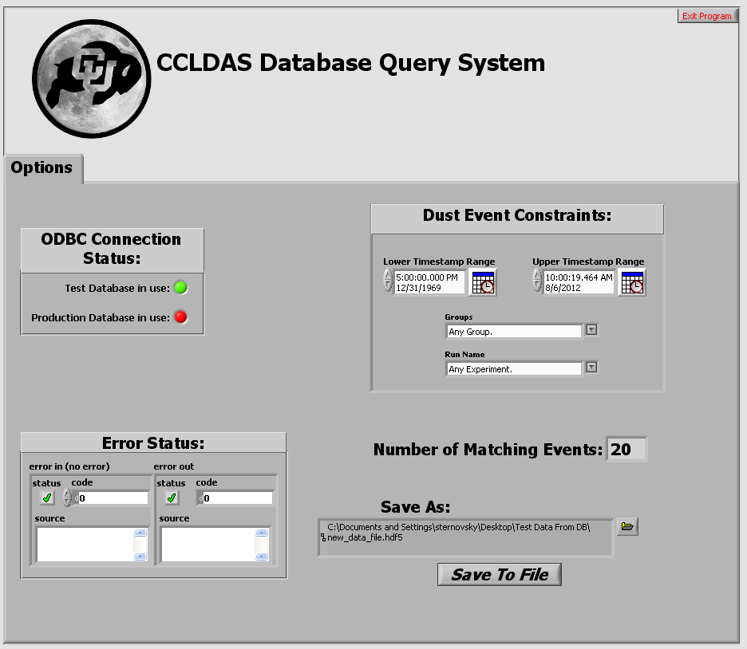
Labview Database Query VI
Data posted to the SQL database can retrieved by Query_Dust_Event.vi. This public VI allows users to select datasets based on a time range, group ID, and experiment name.

Slide 8
Labview Database Query VI
Query_Dust_Event.vi can then write datasets to HDF5 files for analysis.

Slide 9
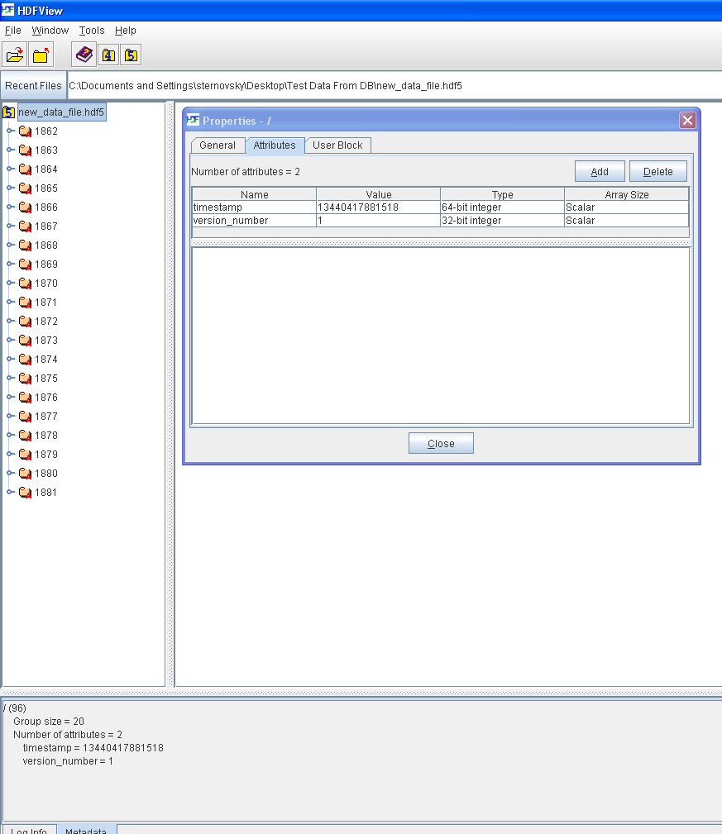
CCLDAS Format For .HDF5 Files
Each file is written with integer timestamp and version number attributes.

Slide 10
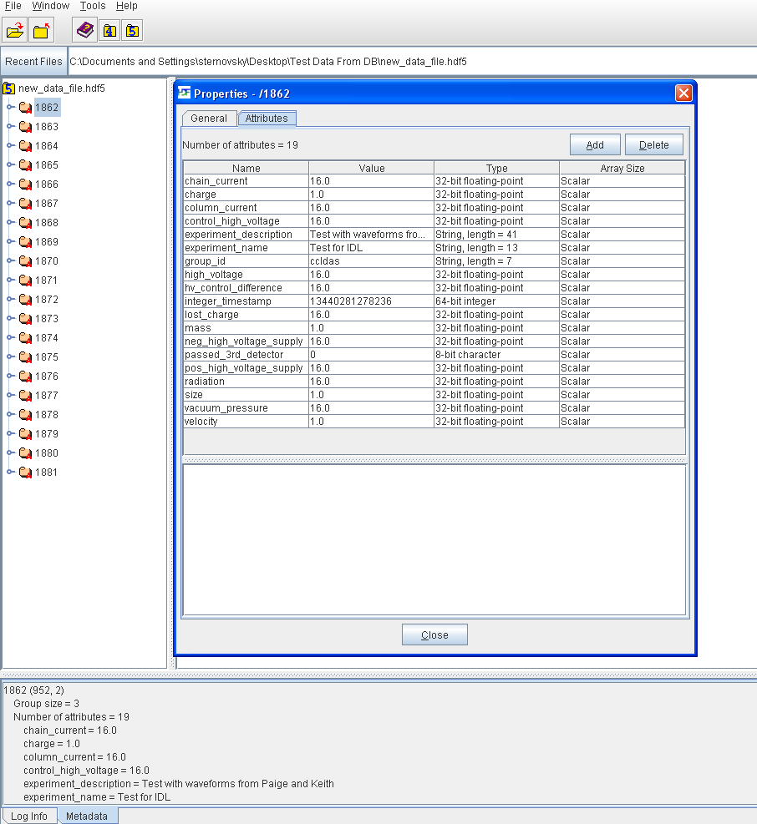
CCLDAS Format For .HDF5 Files
Dust events are stored as individual HDF5 groups. Shot metadata entries are saved as attributes for these dust event groups.

Slide 11
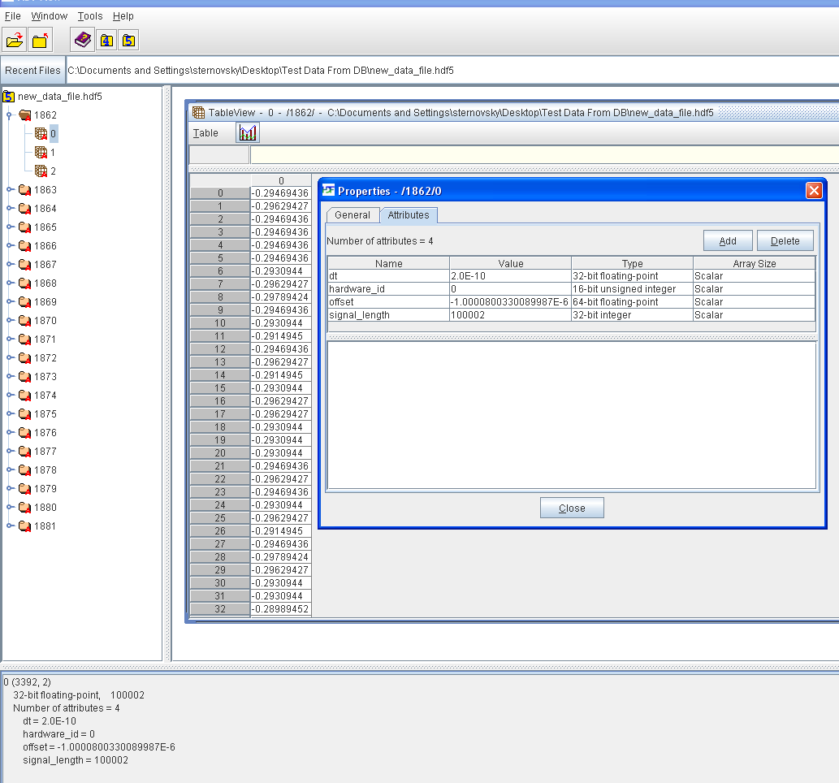
CCLDAS Format For .HDF5 Files
Raw data is stored as datasets in each dust event group, with signal metadata written as dataset attributes.

Slide 12
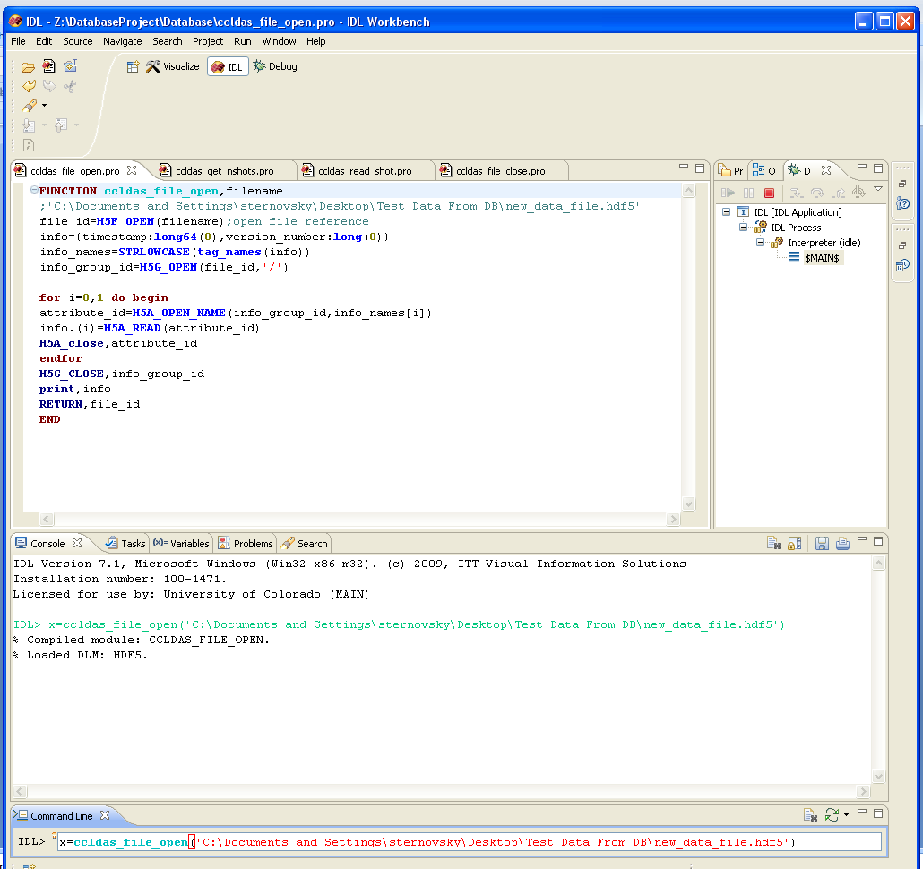
IDL Programs For Reading .HDF5 Files
The function ccldas_file_open can be used to open .HDF5 files in IDL and returns a file reference.
An example syntax would be: x=ccldas_file_open(‘FILENAME')

Slide 13
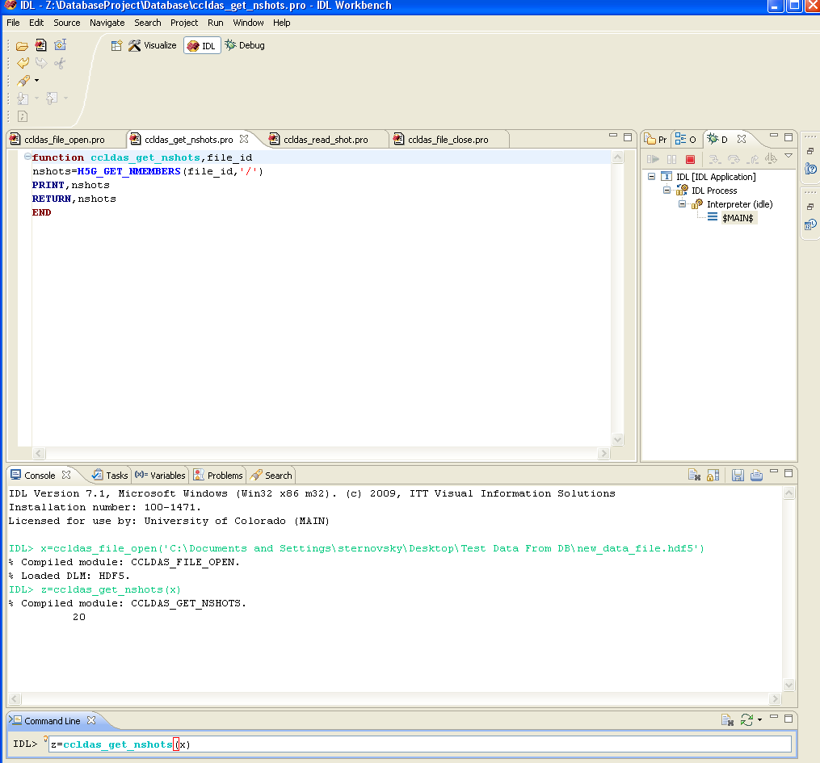
IDL Programs For Reading .HDF5 Files
The function ccldas_get_nshots can be used to count the number of dust event groups in a HDF5 file.
An example syntax would be: z=ccldas_get_nshots(FILE REFERENCE)

Slide 14
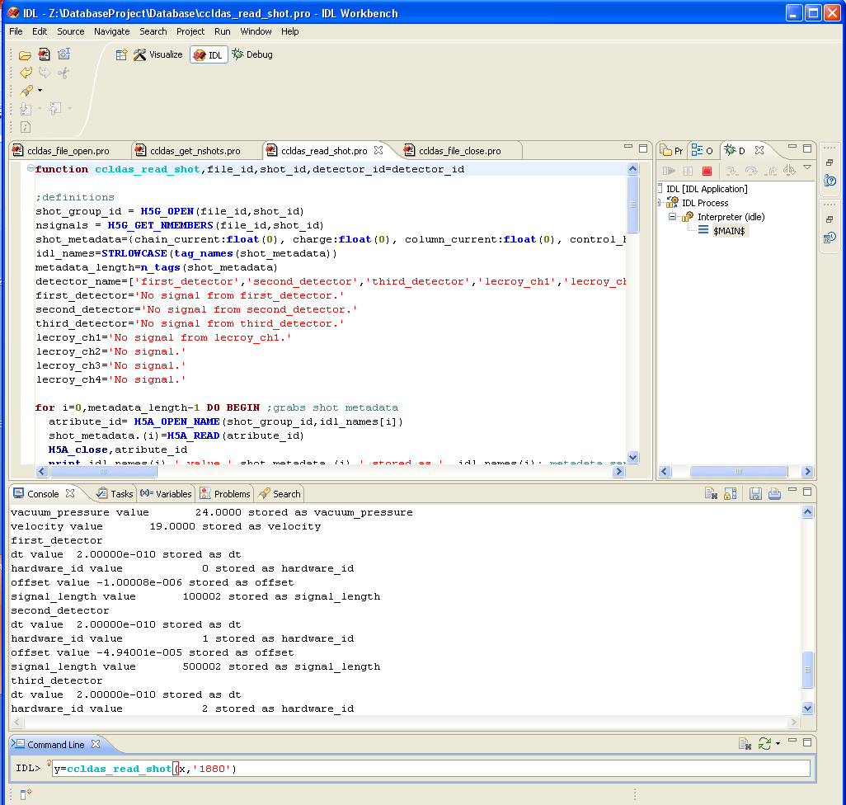
IDL Programs For Reading .HDF5 Files
The function ccldas_read_shot can be used to read dust events. It retrieves metadata and signals and returns them in an output structure that contains output.shot_metadata metadata and output.signals signal structures

Slide 15
IDL Programs For Reading .HDF5 Files
output.shot_metadata includes:
chain_current
charge
column_current control_high_voltage
experiment_description
experiment_name
group_id
high_voltage
hv_control_difference
integer_timestamp
lost_charge
mass
neg_high_voltage_supply
passed_3rd_detector
pos_high_voltage_supply
radiation size
vacuum_pressure
velocity

Slide 16
IDL Programs For Reading .HDF5 Files
An example syntax would be: y=ccldas_read_shot(FILE REFERENCE,‘SHOT GROUP ID')

Slide 17
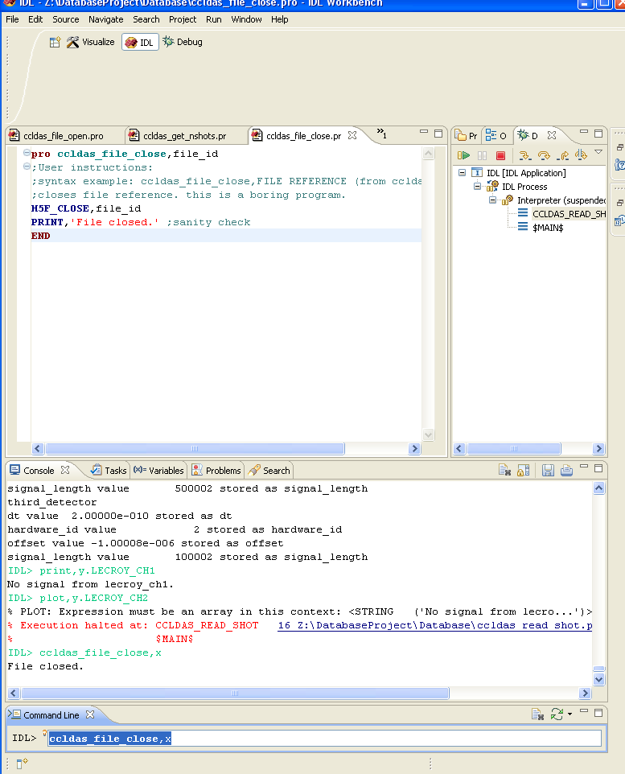
IDL Programs For Reading .HDF5 Files
The procedure ccldas_file_close can be used to close the file reference opened by ccldas_file_open.
An example syntax would be: ccldas_file_close, FILE REFERENCE

Slide 18
